Slide 1
GeoGebra 1 Introduction and Basic
Warabhorn Preechaporn
Training Programme Division
SEAMEO RECSAM

Slide 2
GeoGebra was created by Markus Hohenwarter in 2001/2002 as part of his master's thesis in mathematics education and computer science at the University of Salzburg in Austria.

Slide 3
GeoGebra
GeoGebra is an interactive geometry, algebra, statistics and calculus
application, intended for learning and teaching mathematics and science from primary school to university level.
GeoGebra is available on multiple platforms with its desktop applications for Windows, macOS and Linux, with its tablet apps for Android, iPad and Windows, and with its web application
based on HTML5 technology.

Slide 4
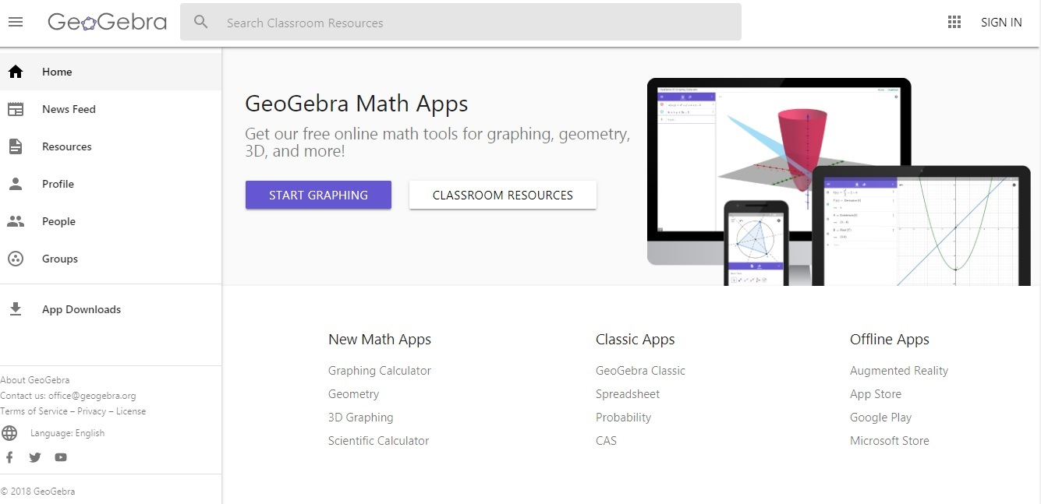
GeoGebra.org

Slide 5
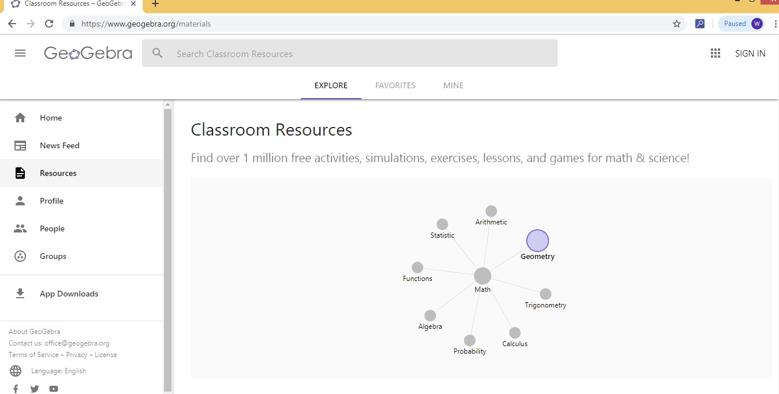
Resources

Slide 6
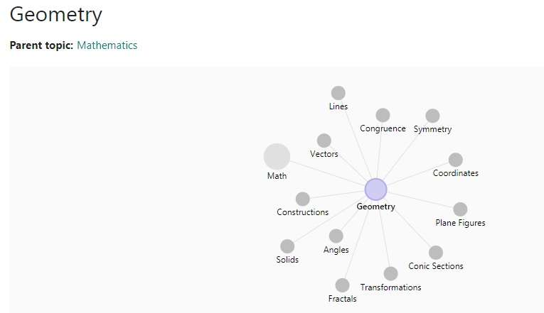

Slide 7
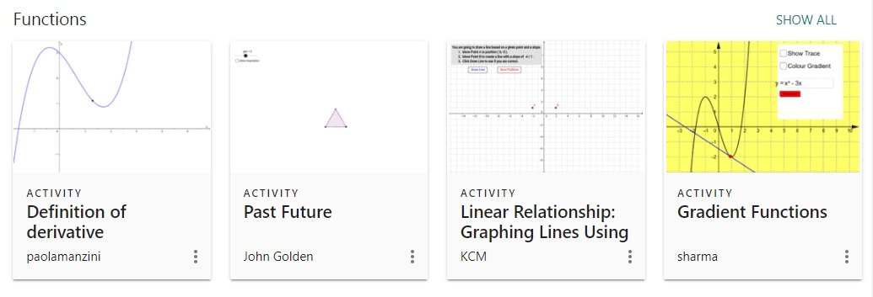
Math Activities

Slide 8
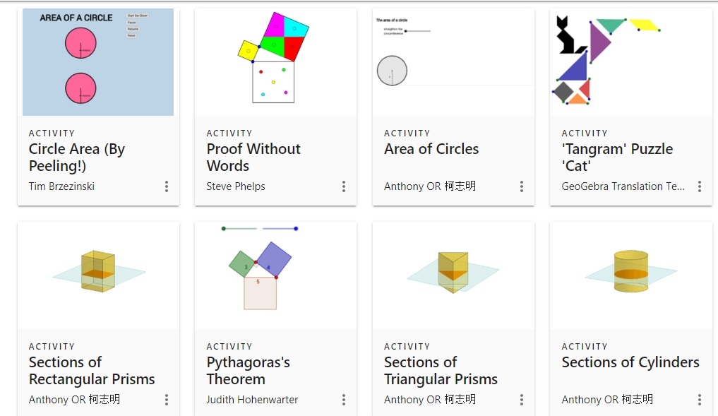
Activities

Slide 9
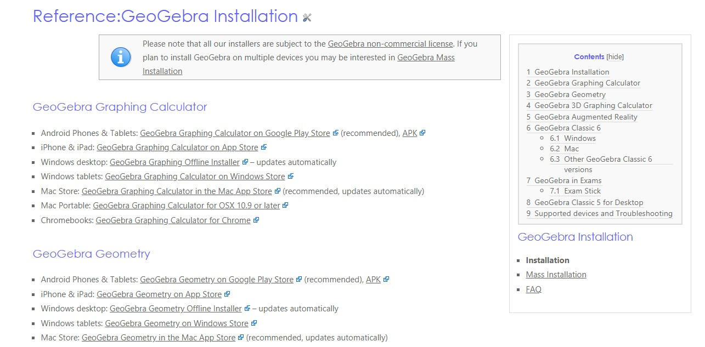
Installation

Slide 10
GeoGebra

Slide 11
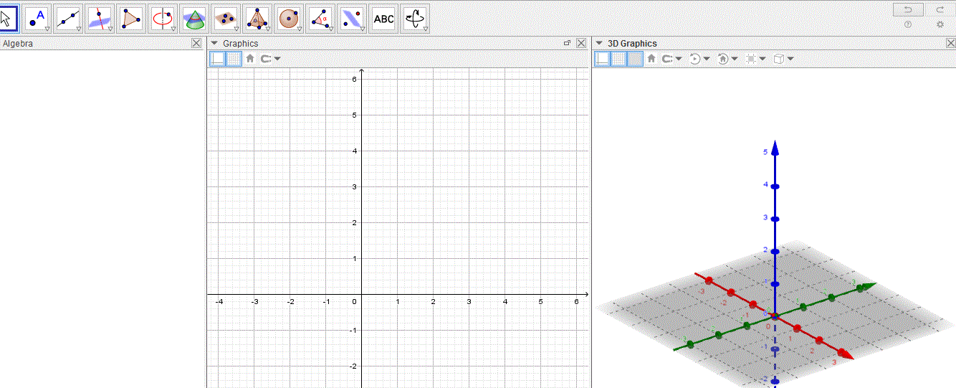
Interface of GeoGebra

Slide 12
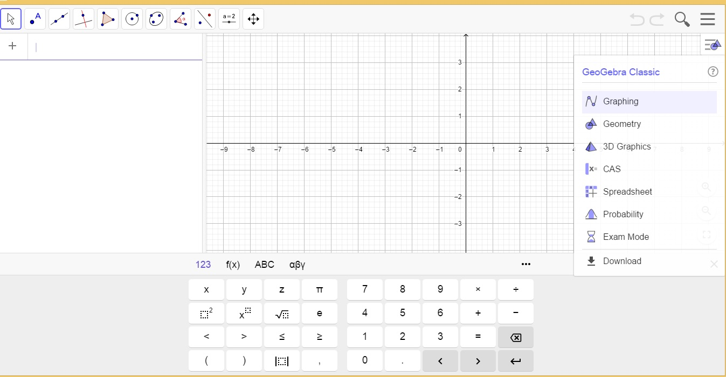
GeoGebra Classic

Slide 13
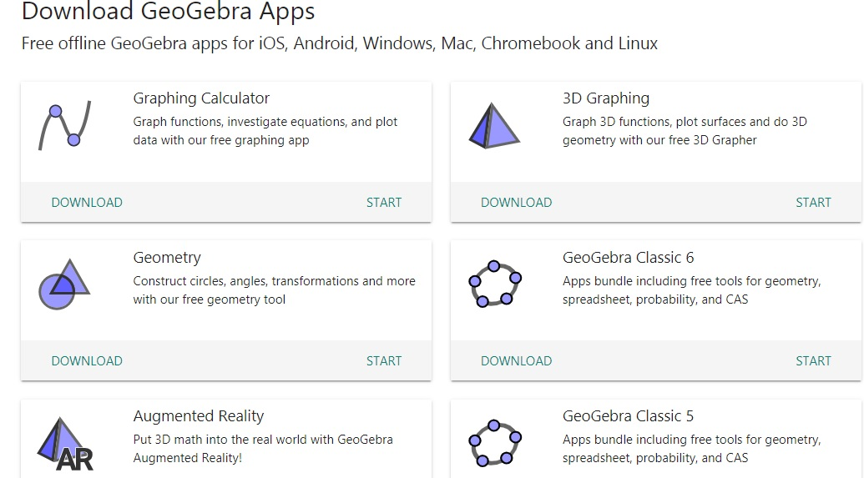
GeoGebra Apps

Slide 14
GeoGebra Classic Apps Tutorials

Slide 15
Classic Apps Tutorials
Graphing
Geometry
3D Graphics
CAS
Spreadsheet
Probability
Exam Mode

Slide 16
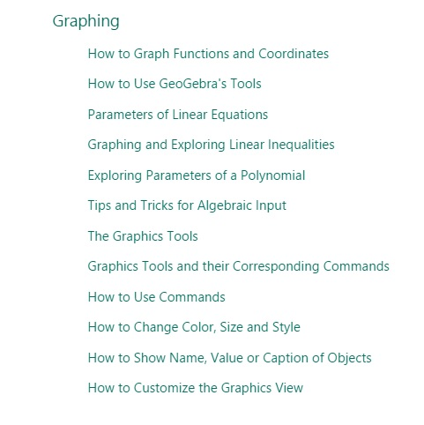
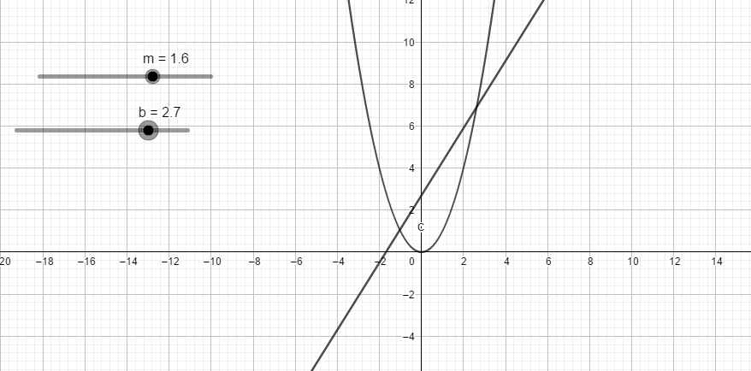
Graphing

Slide 17
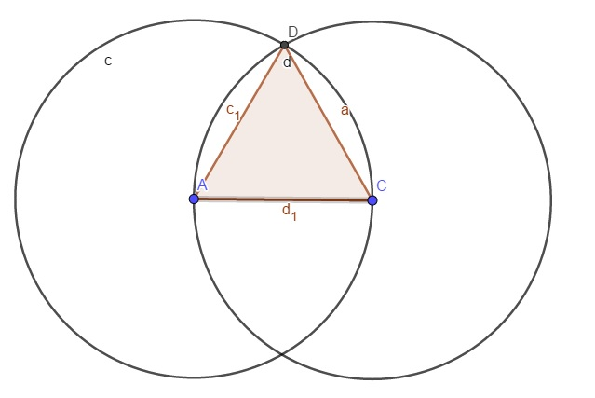
Geometry

Slide 18
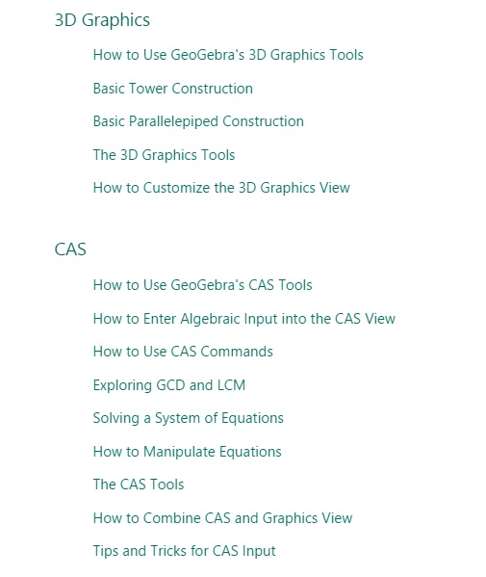
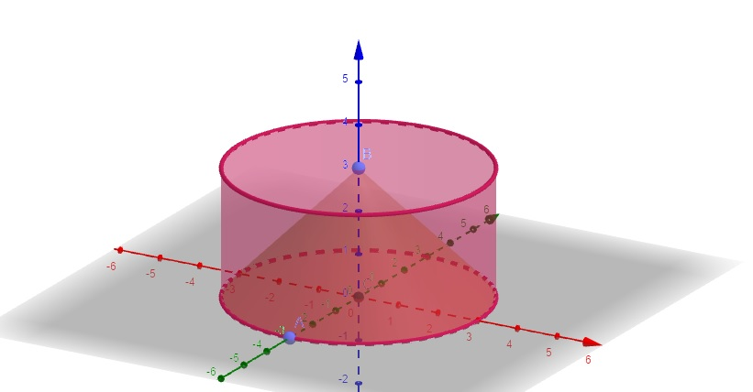
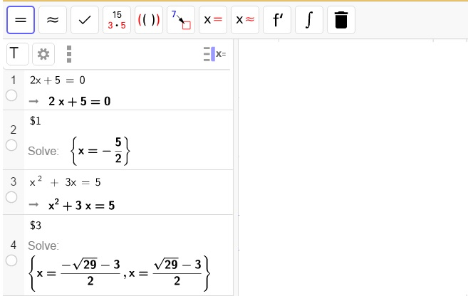
3D Graphics & CAS

Slide 19
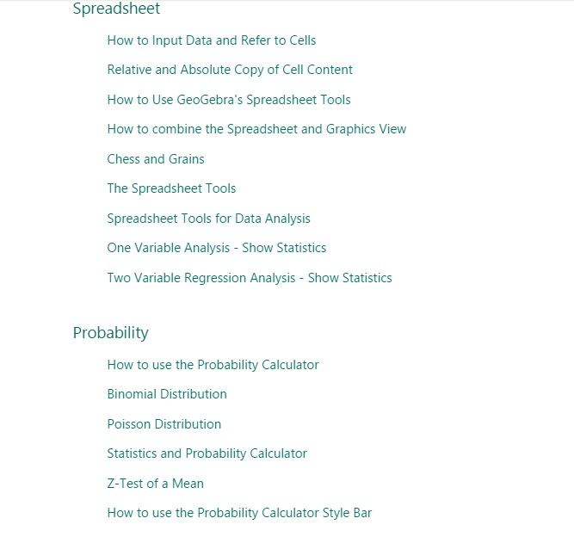
Spreadsheet &
Probability

